Slide 1
Simulate the robot in Gazebo
Final Project

Slide 2
Targets:
Understanding about TFs, GAzebo, RVIZ, URDF and apply to create a robot
In this project you will add a small robotic arm (just 2 axis to keep it simple) on top of the mobile base that we have built together
The end result is a simple robotic arm on top of the mobile base, controlled by a quite simplistic gazebo plugin. So the arm won’t do anything fancy, but that’s not the goal here. The goal is to practise on what we’ve seen in this course, and to open the possibilities for what you can do next. Then after the course, if you want, you can learn more about robotic arm control, for example using the ROS Moveit(2) framework.
The best way to progress is to put in some time and effort to do the project on your own. It’s ok if you don’t manage to do it without help, as it’s a bit more challenging than the challenges I gave you before. But the more you try, the more you’ll learn. Then, if you did the project on your own, I still recommend you watch the solution, so you can compare and also see how I did it + get some best practices

Slide 3
Targets:
Here are the specs you need to create the robot. Note that I didn’t provide all the possible values, just the ones you need to get started. From this you can compute the rest of the values, or (for the gazebo plugins) find more info by searching on the internet.
URDF Links:
  arm_base_link:
    Box: size 0.1 0.1 0.02
    Color: orange
    Mass: 0.5
  forearm_link:
    Cylinder: radius 0.02 length 0.3
    Color: yellow
    Mass: 0.3
  hand_link:
    Cylinder: radius 0.02, length 0.3
    Color: orange
    Mass: 0.3

Slide 4
Targets:
URDF Joints:
  Between arm base and forearm:
    ype: revolute
    Limit: lower 0, upper pi/2, effort 100, velocity 100
    Add some friction with <dynamics friction=”0.05” damping=”0.1” />
  Between forearm and hand:
    Type: revolute
    Limit: lower 0, upper pi/2, effort 100, velocity 100
    Add some friction with <dynamics friction=”0.05” damping=”0.1” />
Gazebo plugins with required fields:
  joint_state_publisher:
    update_rate: 10
    joint_name: one for each joint in the arm
  joint_pose_trajectory:
    update_rate: 2

Slide 5


Targets:
To test the joint_pose_trajectory plugin, run this command from the terminal:
ros2 topic pub -1 /set_joint_trajectory trajectory_msgs/msg/JointTrajectory '{header: {frame_id: arm_base_link}, joint_names: [arm_base_forearm_joint, forearm_hand_joint], points: [ {positions: {0.0, 0.0}} ]}'

Slide 6
Tips to get started
Tips to get started Here are some additional tips to help you with the project::
For the arm, you can create a new URDF file “arm.xacro”, and a “standalone_arm.urdf.xacro”. In the standalone file, you include the “arm.xacro” and “common_properties.xacro”. By doing this you will be able to test the arm on its own, before you attach it to the mobile base.
Work with small iterations: first write the URDF with the links (only visual) and joints. Then, once you know it’s correct, add the collision and inertia. Test again, then add the gazebo material. Test, add one gazebo plugin, test, etc.
You don’t need to recreate any launch file, you can just use the ones that we’ve written previously and modify the URDF file path.
Don’t hesitate to come back to any previous lesson of this course if you need a refresher.

Slide 7
Steps for the project
Step 1: Create the new arm.xacro and standalone_arm.urdf.xacro files, write the links (only visual), joints, and materials. Use RViz to visualise what you build step by step.
Step 2: Add the collision and inertial tags in the links. Add the dynamics tags in the joints. Also create a new xacro file and add the gazebo material tags. Modify the existing launch file in my_robot_bringup to use the standalone_arm.urdf.xacro. Start the robot in gazebo.
Step 3: Add the joint_state_publisher gazebo plugin, so the TFs are correctly
published for the arm (and you can see them on RViz). Then, add the joint_pose_trajectory plugin to control the arm, and send a command from the terminal.
Step 4: integrate the arm in the my_robot.urdf.xacro file. Add a fixed joint between the base_link of the mobile base and the arm_base_link of the arm. Start and test the robot in gazebo using the launch file in my_robot_bringup.

Slide 8
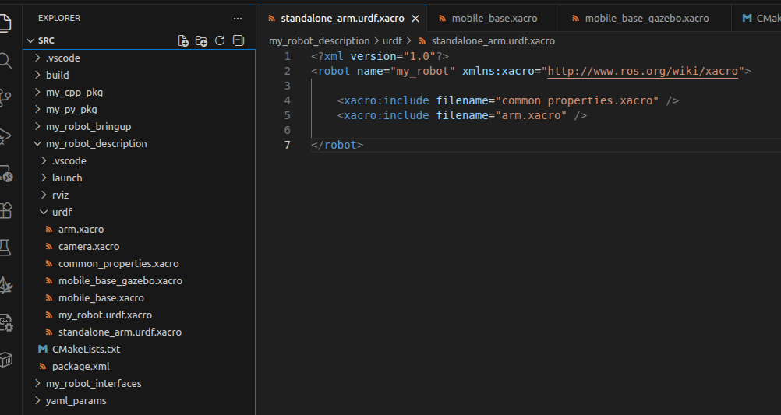
Step 1 - URDF Links and Joints
Create the xacro files for arm robot: arm.xacro and standalone_arm.urdf.xacro

Slide 9
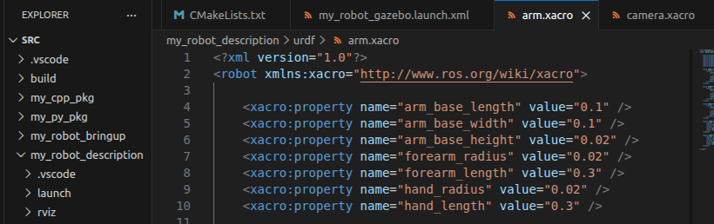
Step 1 - URDF Links and Joints
Create xacro property for arm.xacro

Slide 10
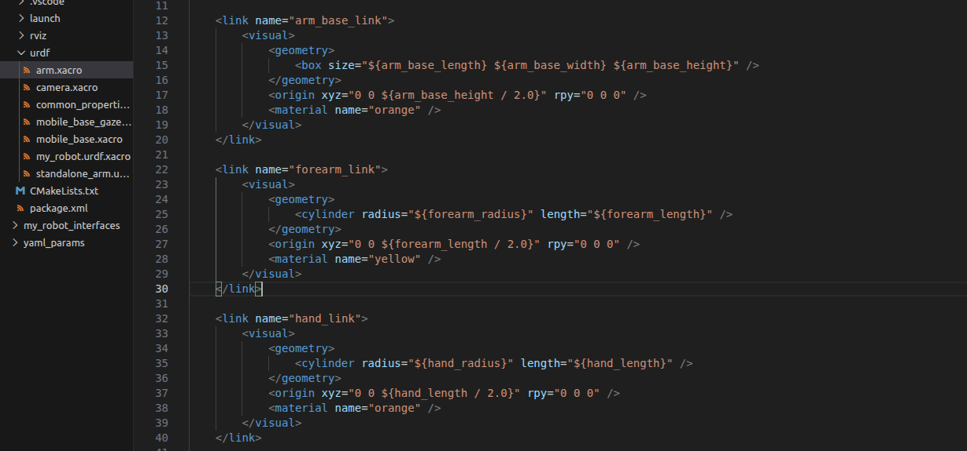
Step 1 - URDF Links and Joints
Create links for arm_base, forearm, hand in arm.xacro

Slide 11
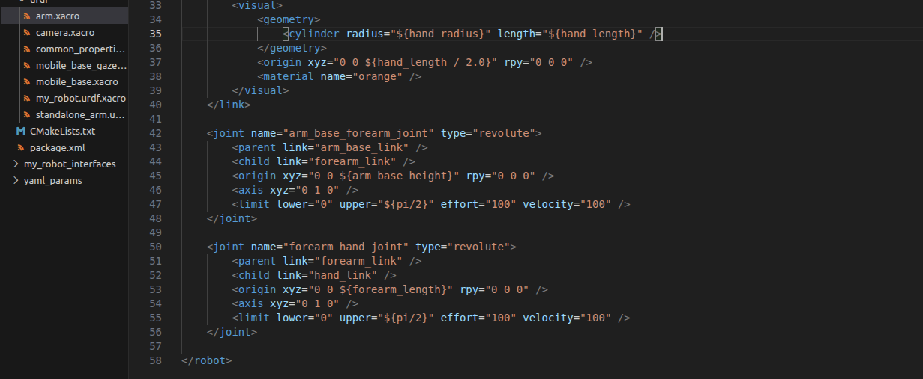
Step 1 - URDF Links and Joints
Create Joints for arm_base, forearm, hand in arm.xacro

Slide 12
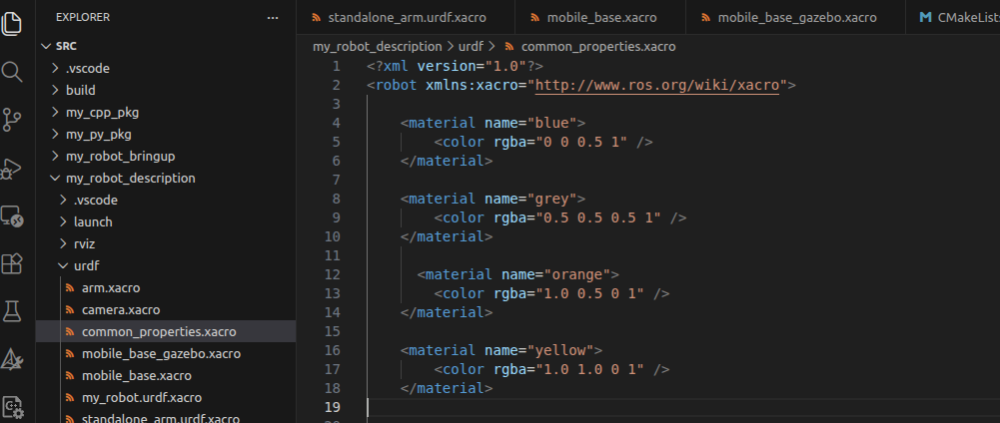
Step 1 - URDF Links and Joints
Add orange and yellow to color properties

Slide 13
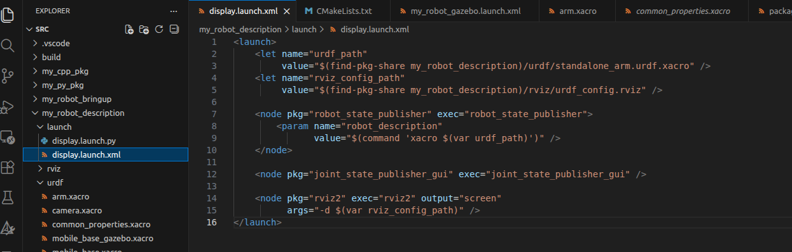
Step 1 - URDF Links and Joints
change urdf to standalone_arm.urdf.xacro

Slide 14
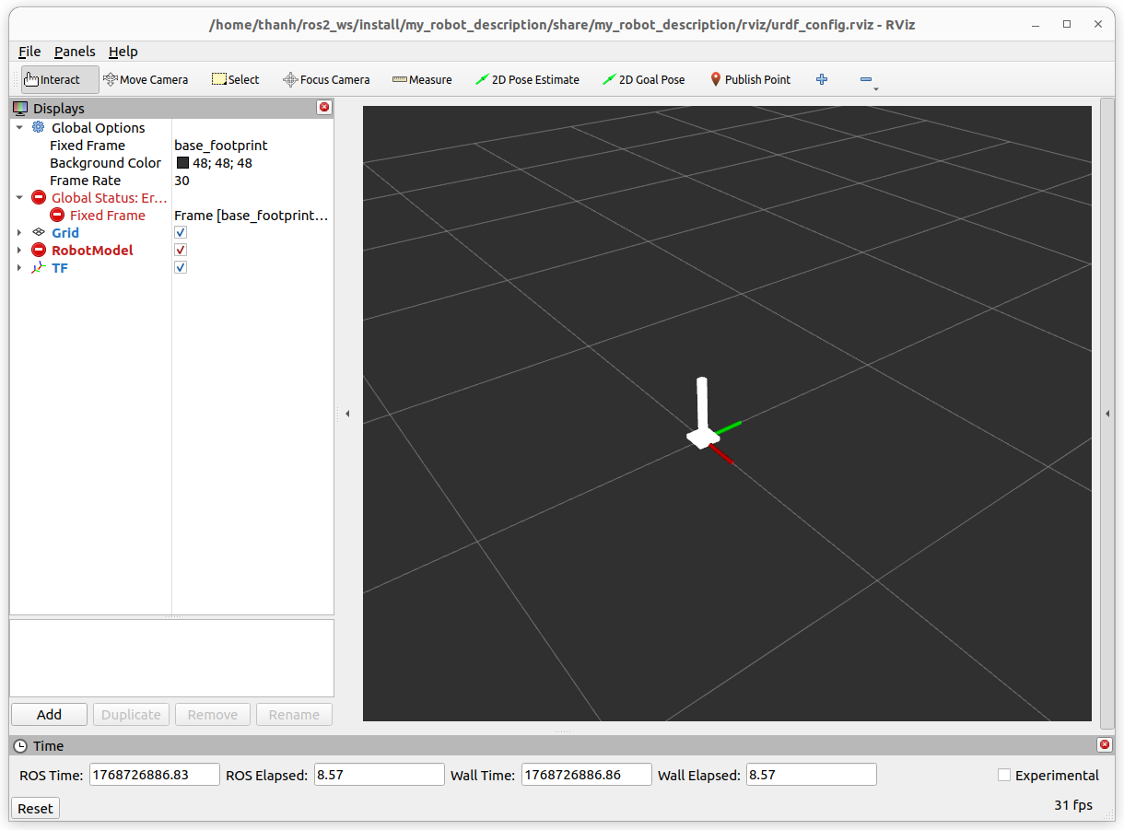
Step 1 - URDF Links and Joints
colcon build
launch on RVIZ: ros2 launch my_robot_description.xml
In the red box, there are errors because of fixed frame is base_footprint

Slide 15
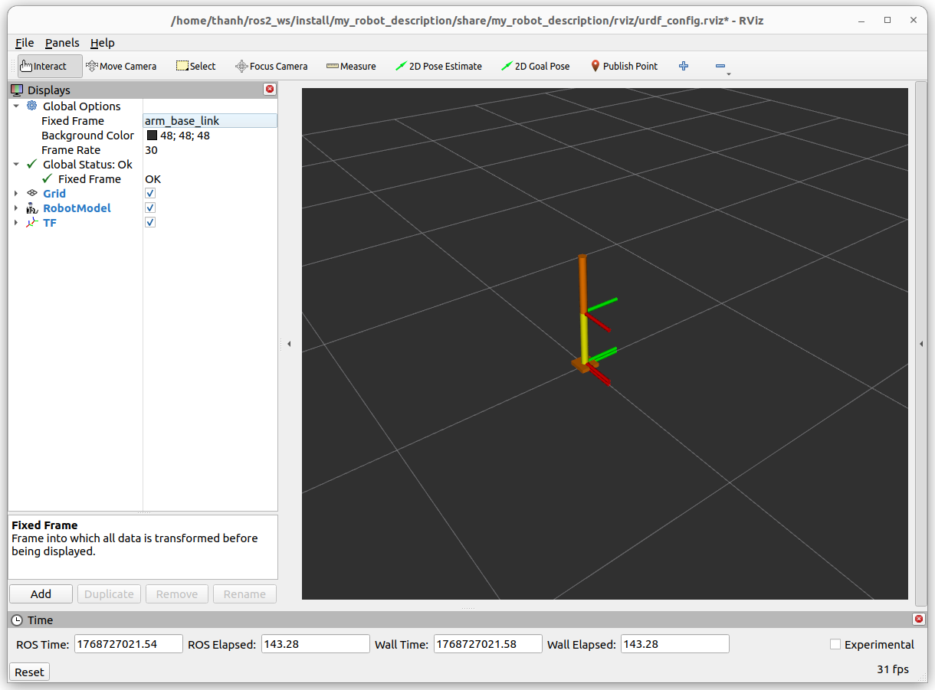
Step 1 - URDF Links and Joints
Change fixed frame to arm_base_link, it will be ok, because the arm has no base_footprint frame

Slide 16
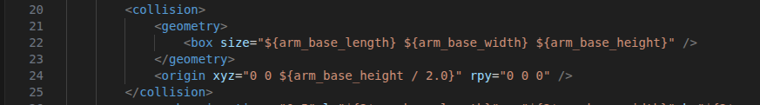
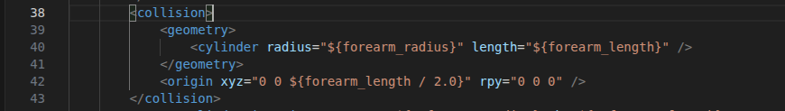
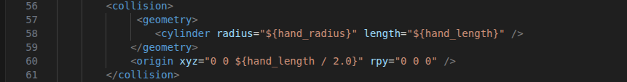
Step 2 - Adapt the Robot for Gazebo
Add collision type for arm_base_link, forearm_link, hand_link in arm.xacro
arm_base
forearm
hand

Slide 17
Step 2 - Adapt the Robot for Gazebo
Add inertia type for arm_base_link, forearm_link, hand_link,
arm_base
forearm
hand

Slide 18
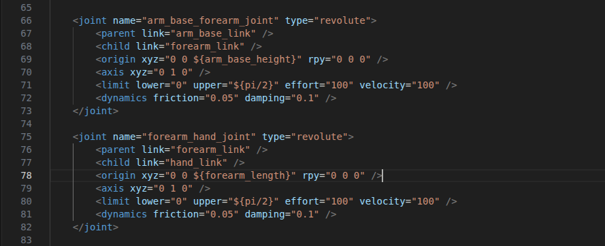
Step 2 - Adapt the Robot for Gazebo
Add friction and damping type for arm_base_forearm_joint, and forearm_hand_joint in arm.xacro
    Add some friction with <dynamics friction=”0.05” damping=”0.1” />

Slide 19
Step 2 - Adapt the Robot for Gazebo
This step, we just run on standalone robot arm. Then we need to config on launch files to run standalone_arm.urdf.xacro
On the urdf path of my_robot_description/launch/display.launch.xml and my_robot_bringup/launch/my_robot_gazebo.launch.xml

Slide 20
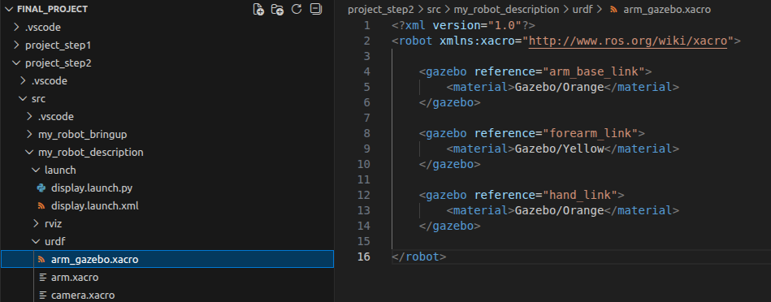
Step 2 - Adapt the Robot for Gazebo
To create the color for links of robot arm, similarly mobile_base, we create file arm_gazebo.xacro in my_robot_description/urdf/

Slide 21
Step 2 - Adapt the Robot for Gazebo
Rebuild the packages and launch on gazebo and rviz to view results

Slide 22
Step 3 - Add Gazebo Plugins
Gazebo plugins with required fields:
  joint_state_publisher:
    update_rate: 10
    joint_name: one for each joint in the arm
  joint_pose_trajectory:
    update_rate: 2

Slide 23
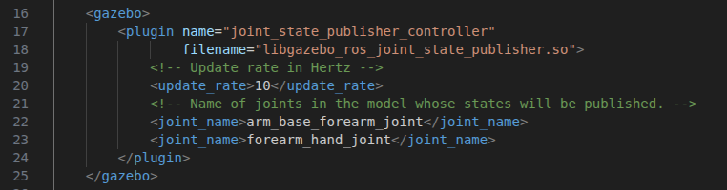
Step 3 - Add Gazebo Plugins
Add the joint_state_publisher gazebo plugin in ../urdf/arm_gazebo.xacro
gazebo library for joint state publisher
define the joint state publisher controller
update_rate: 10

Slide 24
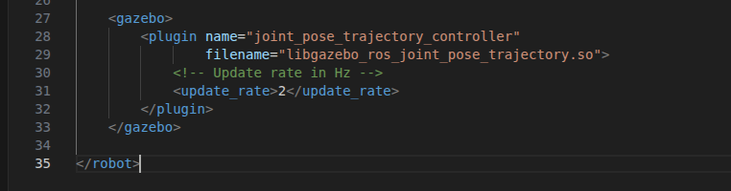
Step 3 - Add Gazebo Plugins
add the joint_pose_trajectory plugin to control the arm in ../arm_gazebo.xacro
gazebo library for joint pose trajectory
define the joint pose trajectory controller
update_rate: 2

Slide 25
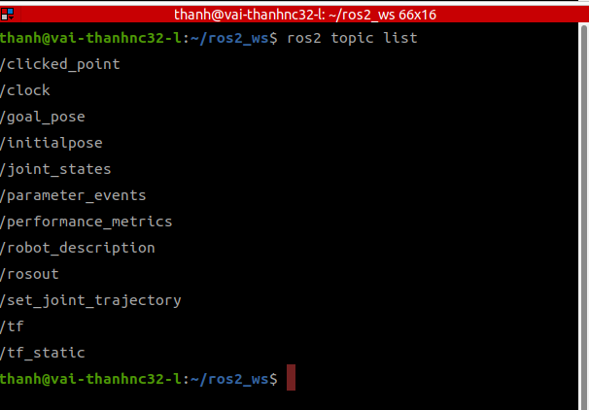
Step 3 - Add Gazebo Plugins
rebuild the packages
launch: ros2 launch my_robot_bringup my_robot_gazebo.launch.xml
ros2 topic list

Slide 26
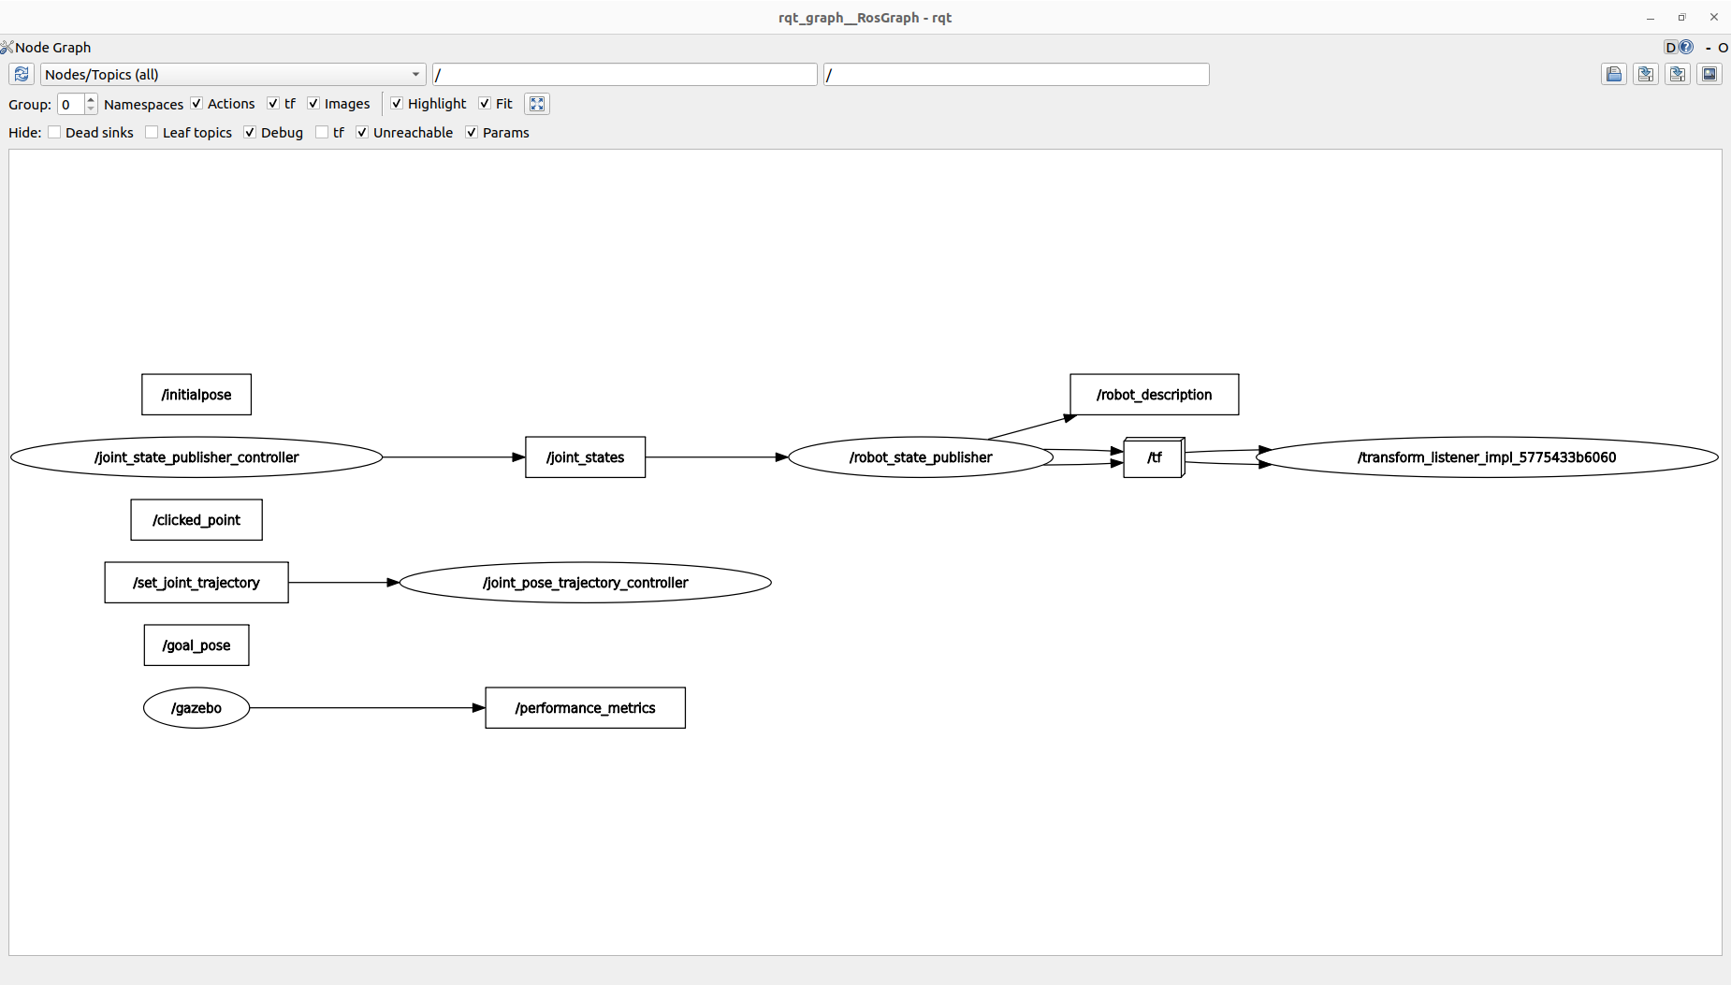
Step 3 - Add Gazebo Plugins
rqt_graph

Slide 27
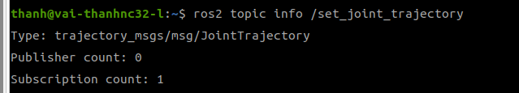
Step 3 - Add Gazebo Plugins
Check topic info of topic /set_joint_trajectory we see interface trajectory_msgs/msg/JointTrajectory

Slide 28
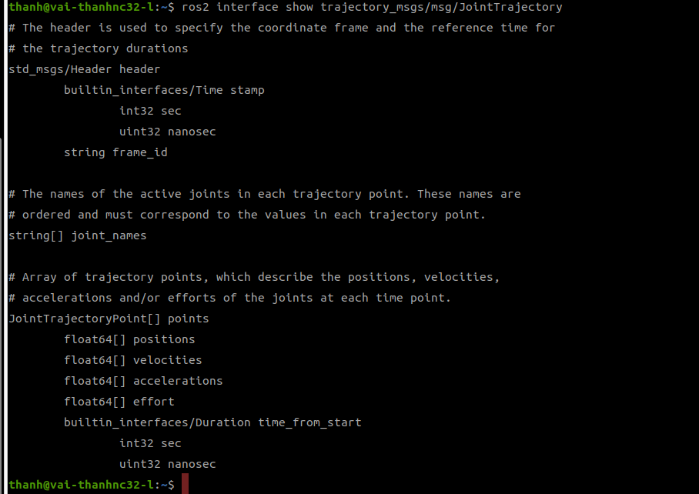
Step 3 - Add Gazebo Plugins
Check interface trajectory_msgs/msg/JointTrajectory
ros2 interface show trajectory_msgs/msg/JointTrajectory

Slide 29
Step 3 - Add Gazebo Plugins
To test the joint_pose_trajectory plugin, run this command from the terminal: ros2 topic pub -1 /set_joint_trajectory trajectory_msgs/msg/JointTrajectory '{header: {frame_id: arm_base_link}, joint_names: [arm_base_forearm_joint, forearm_hand_joint], points: [ {positions: {0.0, 0.0}} ]}'
We can change the values in positions:{}
You can see the video

Slide 30
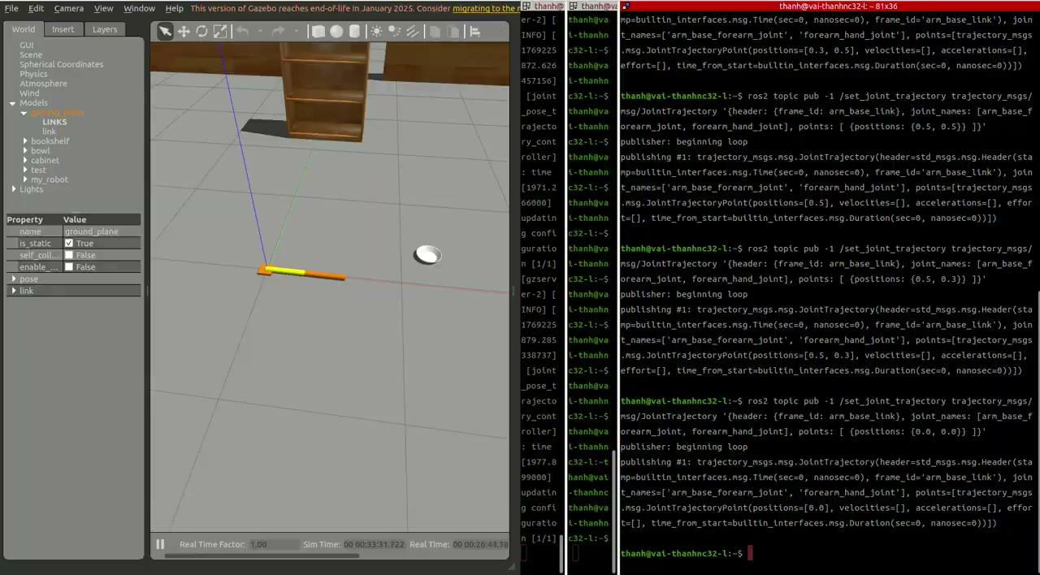
Step 3 - Add Gazebo Plugins

Slide 31
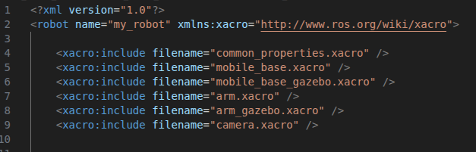
Step 4 - Combine the 2 Robots
This section, we combine mobile robot and arm robot in a unified robot.
the urdf xacro file my_robot.urdf.xacro is main
We insert arm and arm gazebo into my_robot.urdf.xacro as:

Slide 32
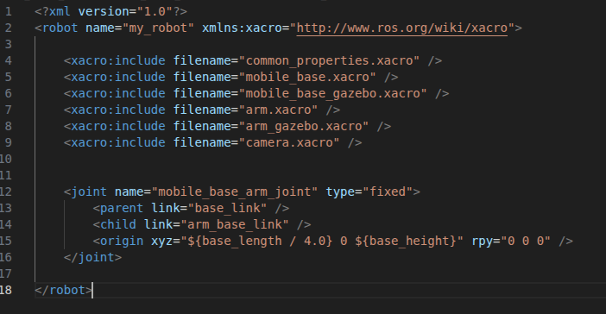
Step 4 - Combine the 2 Robots
To combine 2 robots, we create joint to connect 2 robots

Slide 33
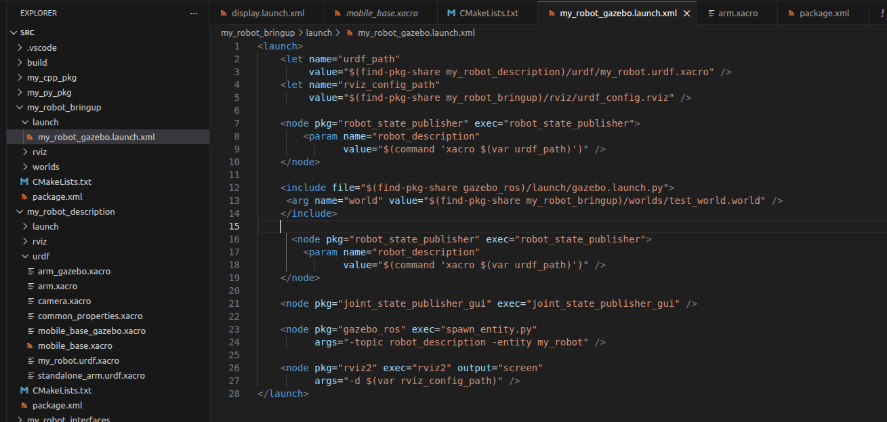
Step 4 - Combine the 2 Robots
Return the urdf_path is my_robot.urdf.xacro

Slide 34
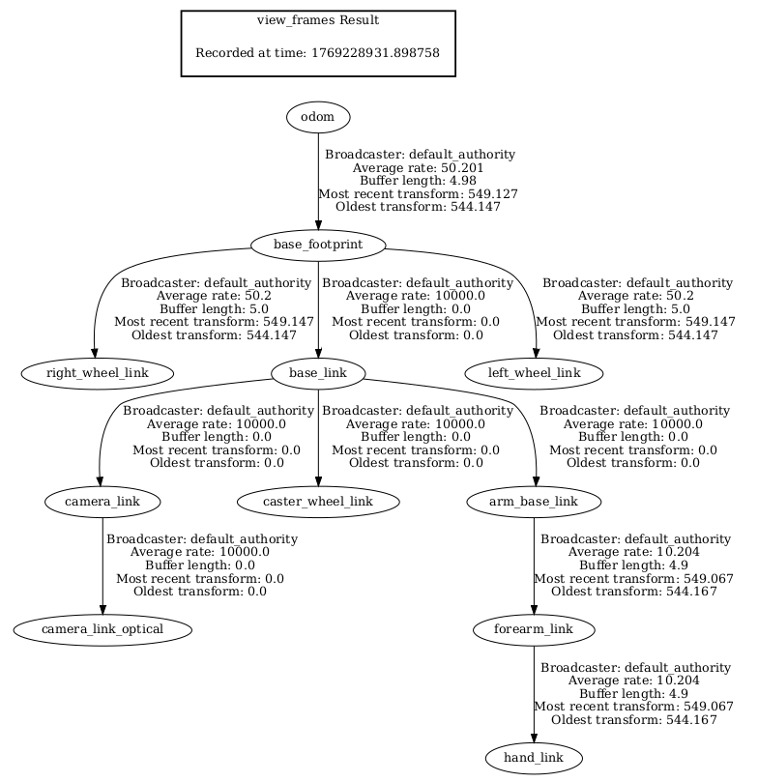
Step 4 - Combine the 2 Robots
rebuild by colcon build
launch gazebo: ros2 launch my_robot_bringup my_robot_gazebo.launch.xml
to check the frames of combined robot: ros2 run tf2_tools view_frames -o complete_robot

Slide 35
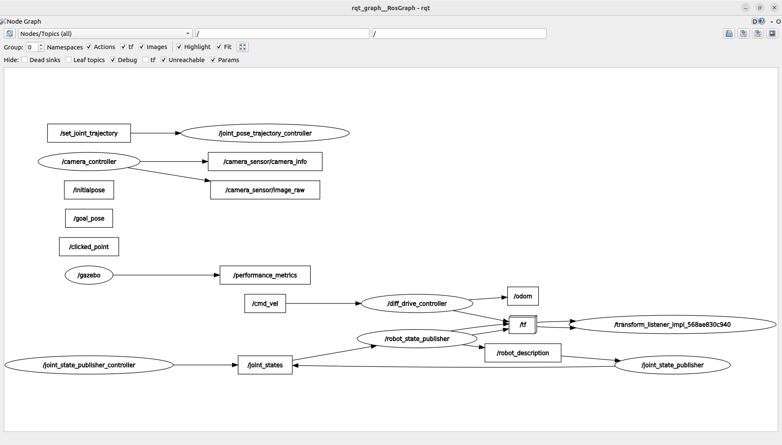
Step 4 - Combine the 2 Robots
rqt_graph

Slide 36
Step 4 - Combine the 2 Robots
send command to control the motion of mobile robot and behavior of arm

Slide 37
Conclusion

Slide 38
What you have learned?
what is TF
Create URDF with links and joints
Robot description package with configure and lunch file
Improve URDF with Xacro - properties, macros
Add inertia and collision tags in URDF
Gazebo plugins
Spawn the robot in Gazebo
Robot bringup package with Gazebo launch file
Create a world with objects and walls
Add a sensor to the robot
Add a robot arm on top of mobile robot

